Slide 1

ONLINE SHOPPING MALL MANAGEMENT SYSTEM
Deepak Dansena - CAP203010
Meghana D S - CAP202025
Nidhi K S - CAP202025
Pooja C - CAP202031
Pruthvi S - CAP203125
Syed Mustaq Ahamed – CAP203236

Slide 2
OBJECTIVE
To create Online Shopping Mall Management System that keeps record of owner, user, customer, employee, item and shop details.
our project is to create an e-commerce like website to provide the customers an easy way of shopping.
It is an attempt to provide the advantages of online shopping to customers of a real shop to buy the products of the shop anywhere through internet.

Slide 3
ABSTRACT
“Online shopping mall” is the process whereby consumers directly buy goods or services from a seller in real-time.
without an intermediary service, over the Internet. It is a form of electronic commerce.
This project “Online shopping mall System” is a web based shopping system for an
existing shop.

Slide 4

ROAD MAP
Application is developed in :
1.Front end : HTML, CSS , JavaScript
2.Back end : JAVA, JSP, SERVLETS, JDBC, MYSQL

Slide 5
MODULES
user
customer
owner

Slide 6
EVENT FLOW
Main page
Signup/Login
shop
user
Search
View
Logout

Slide 7
Change Password
Add items
Admin
Login
Main Page
edit items
Logout
delete items

Slide 8
customer
Sign Up/Login
Main Page
Shop
Logout

Slide 9
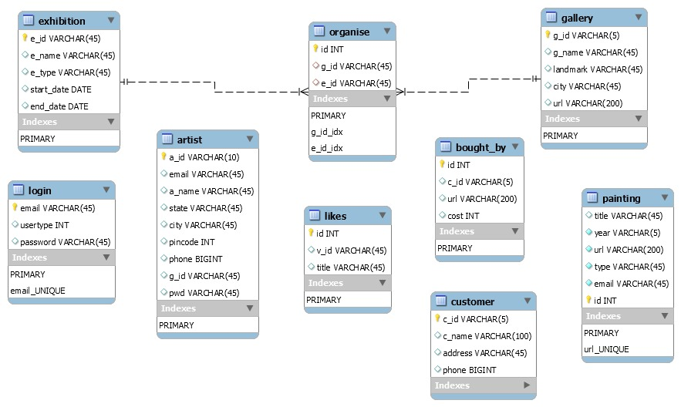
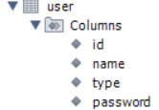
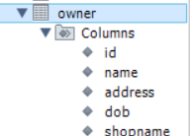
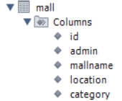
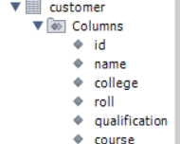

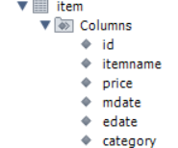
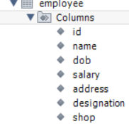
SCHEMA DIAGRAM

Slide 10
ER DIAGRAM
name
address
id
id
shopname
mall
name
owner
adds
mall
admin
location
category
id
adds
name
itemid
user
itemname
type
price
id
item
password
customer
qualitfication
name
mdate
college
category
edate
roll
course

Slide 11
SCREENSHOTS

Slide 12
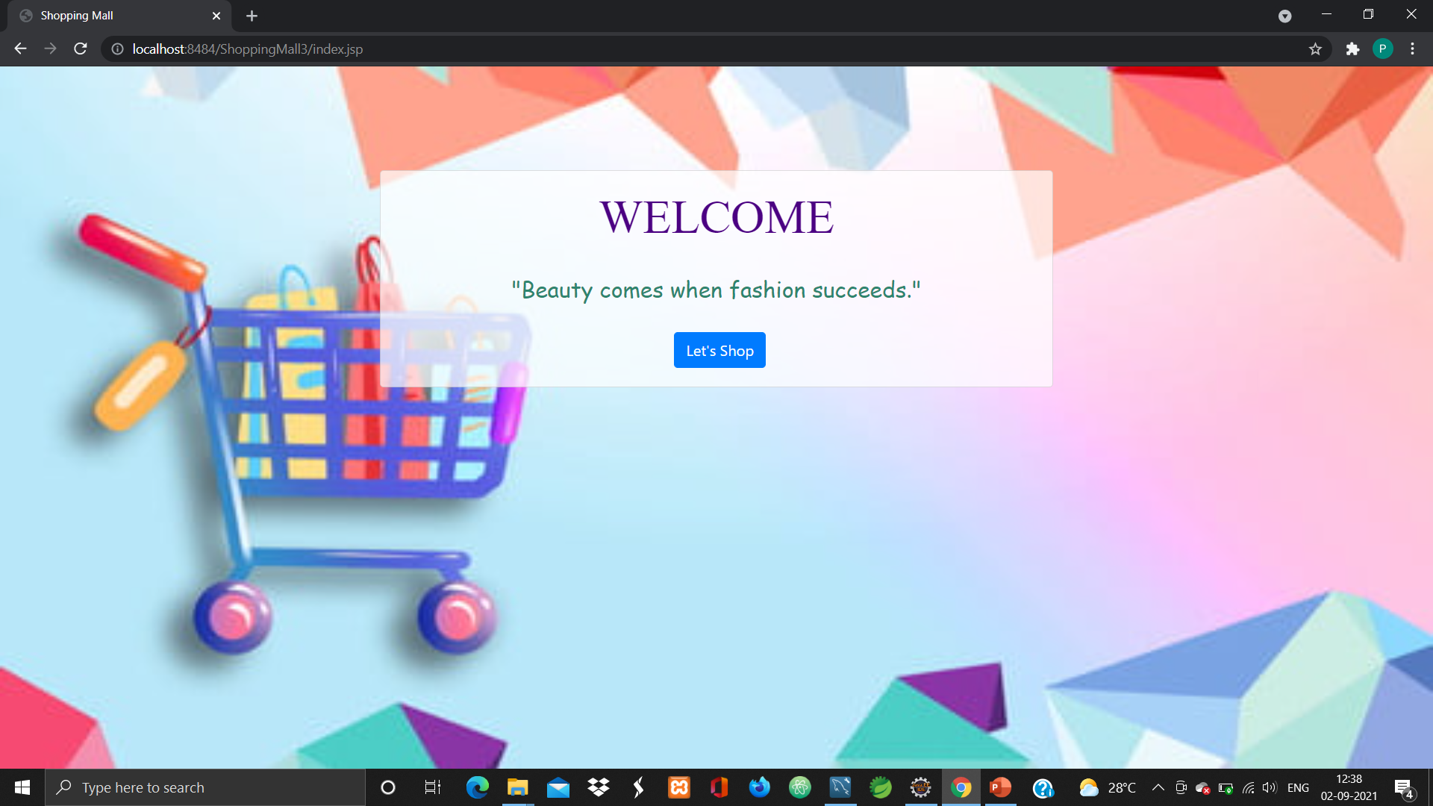

Slide 13
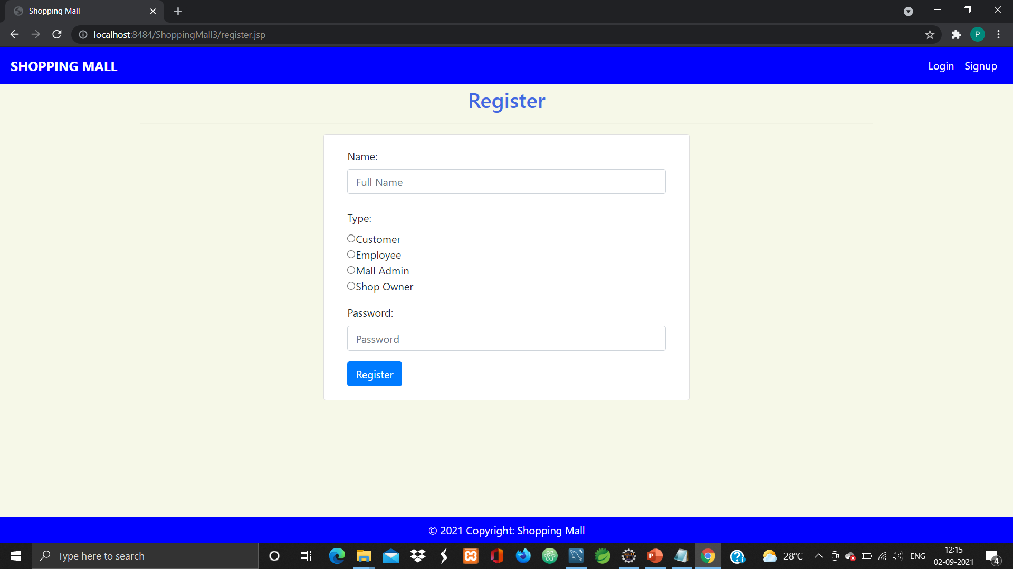

Slide 14
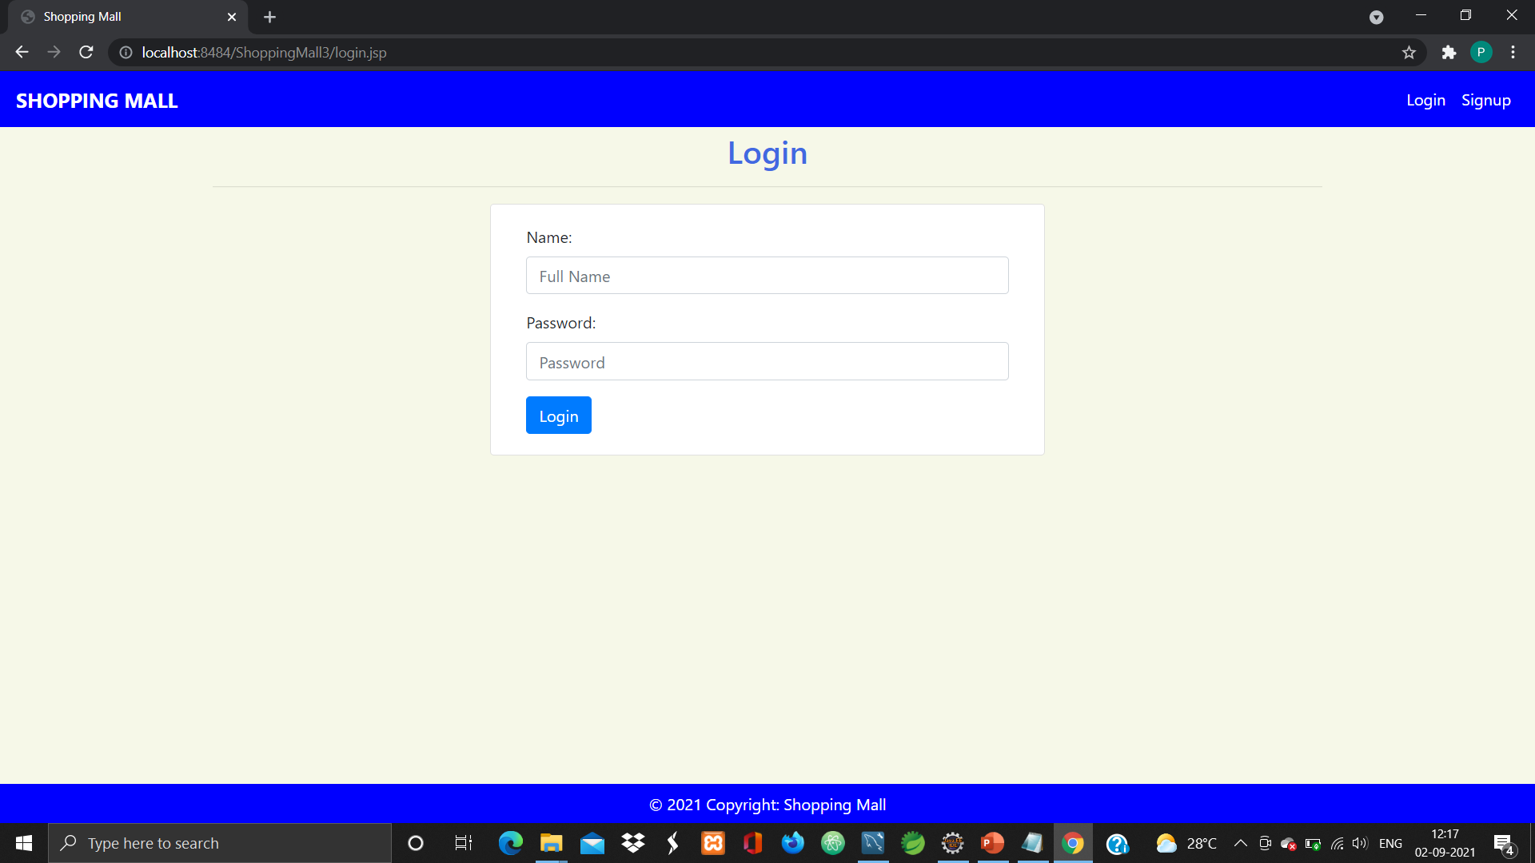

Slide 15
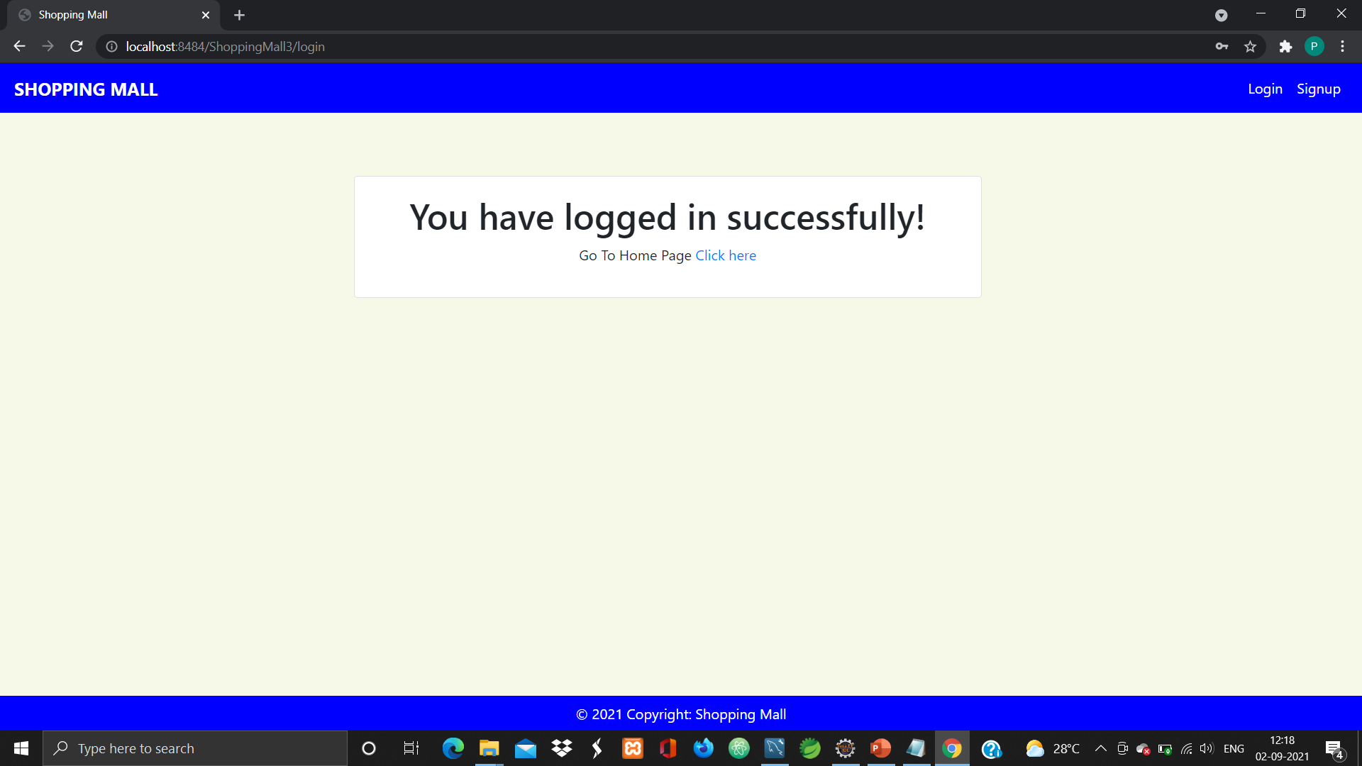

Slide 16
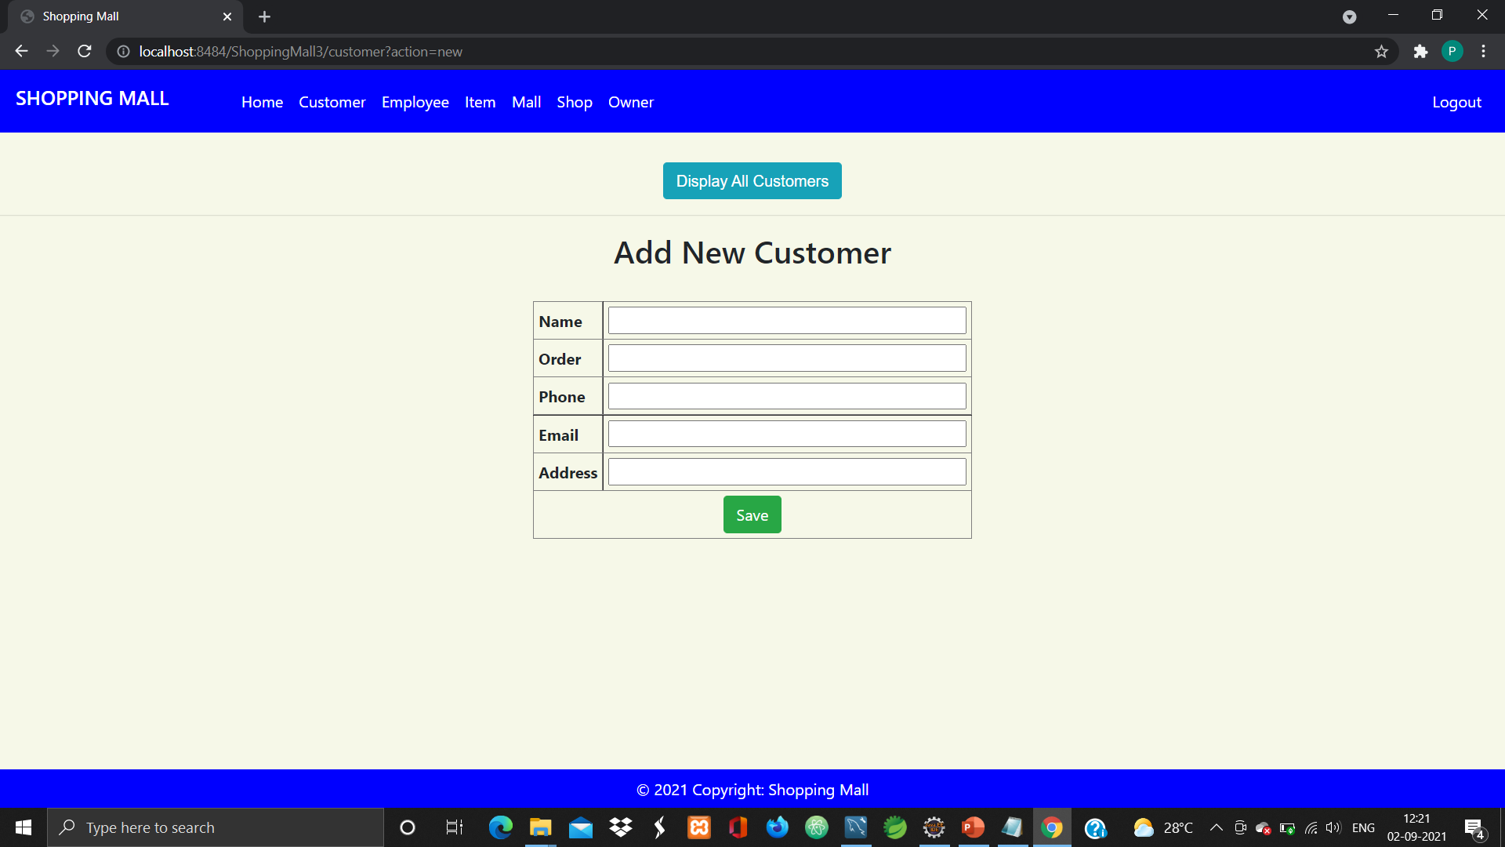

Slide 17
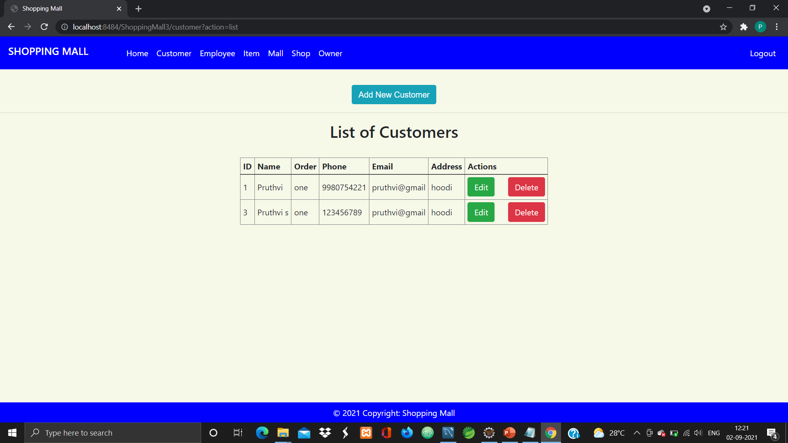

Slide 18
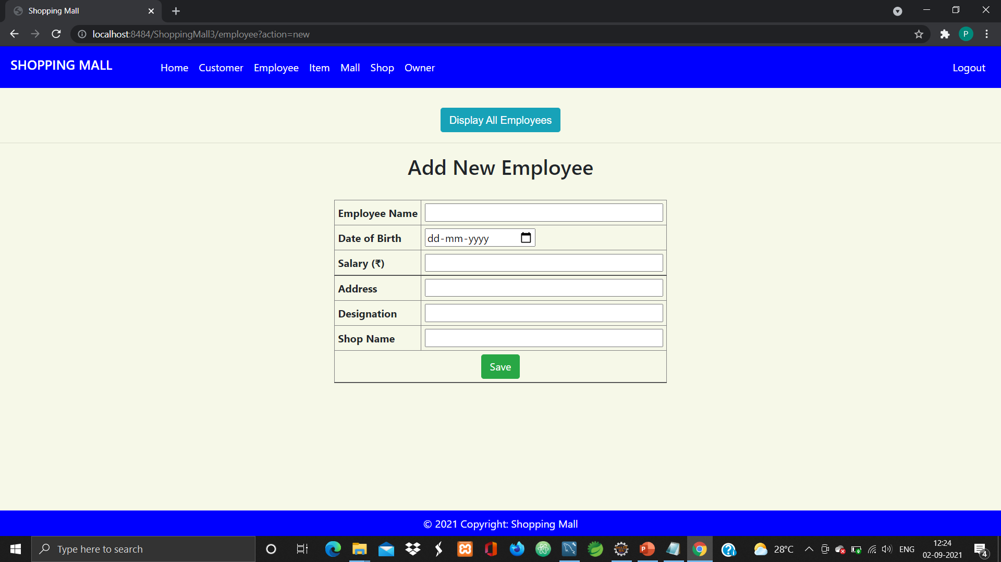

Slide 19
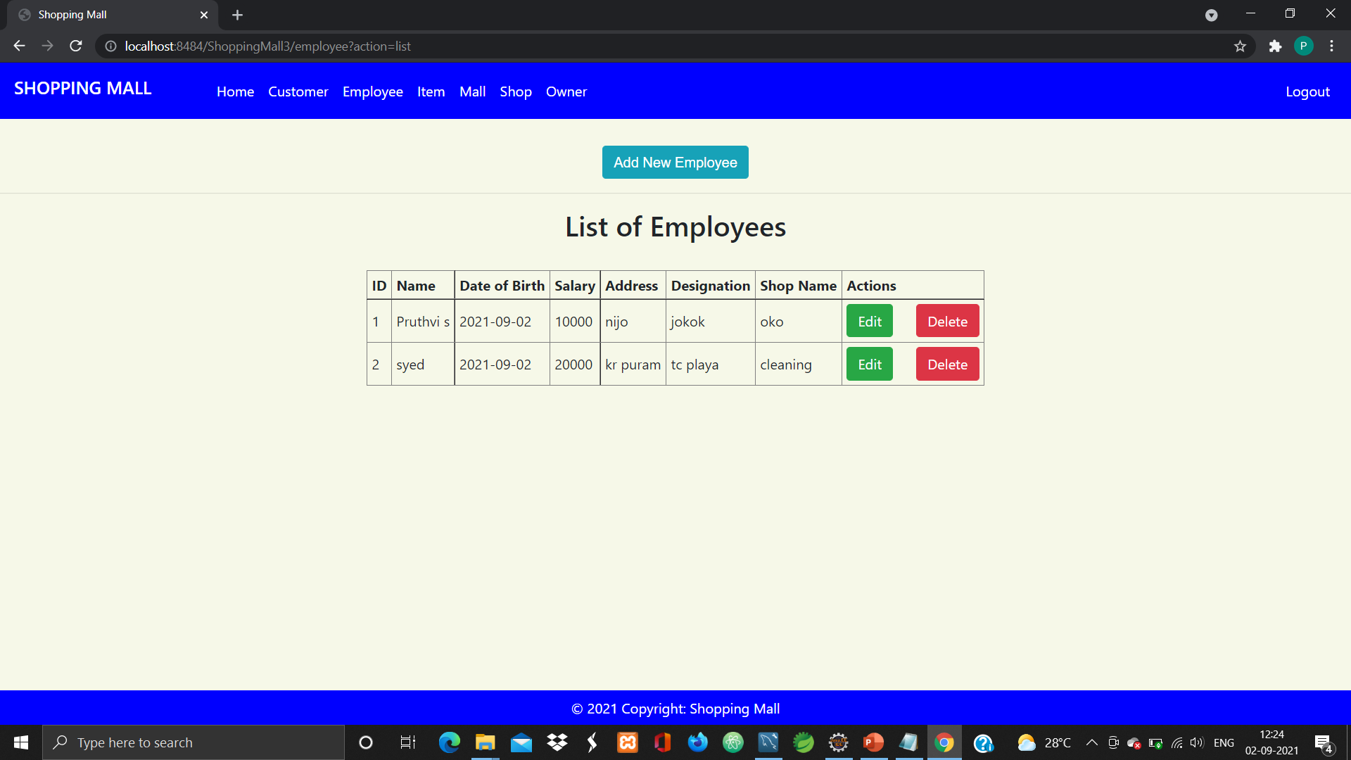

Slide 20
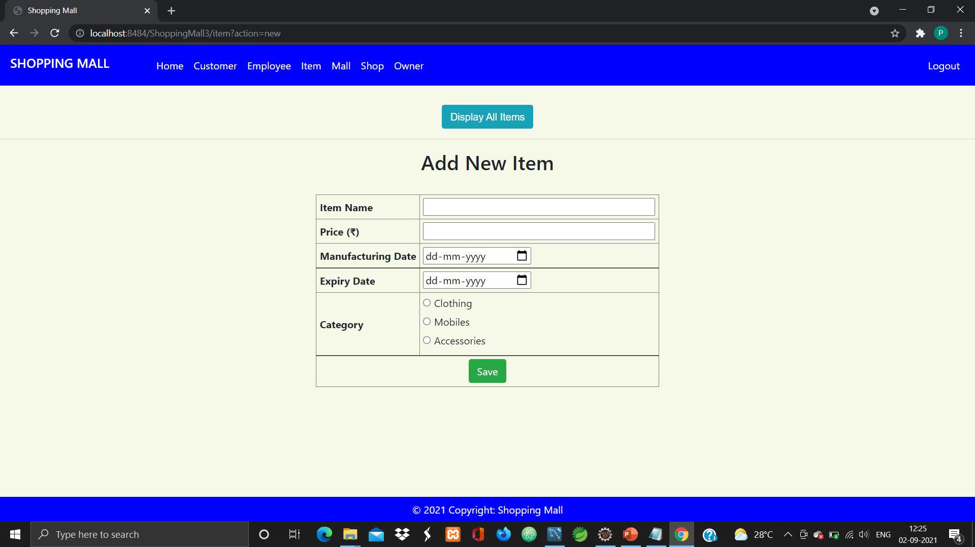

Slide 21
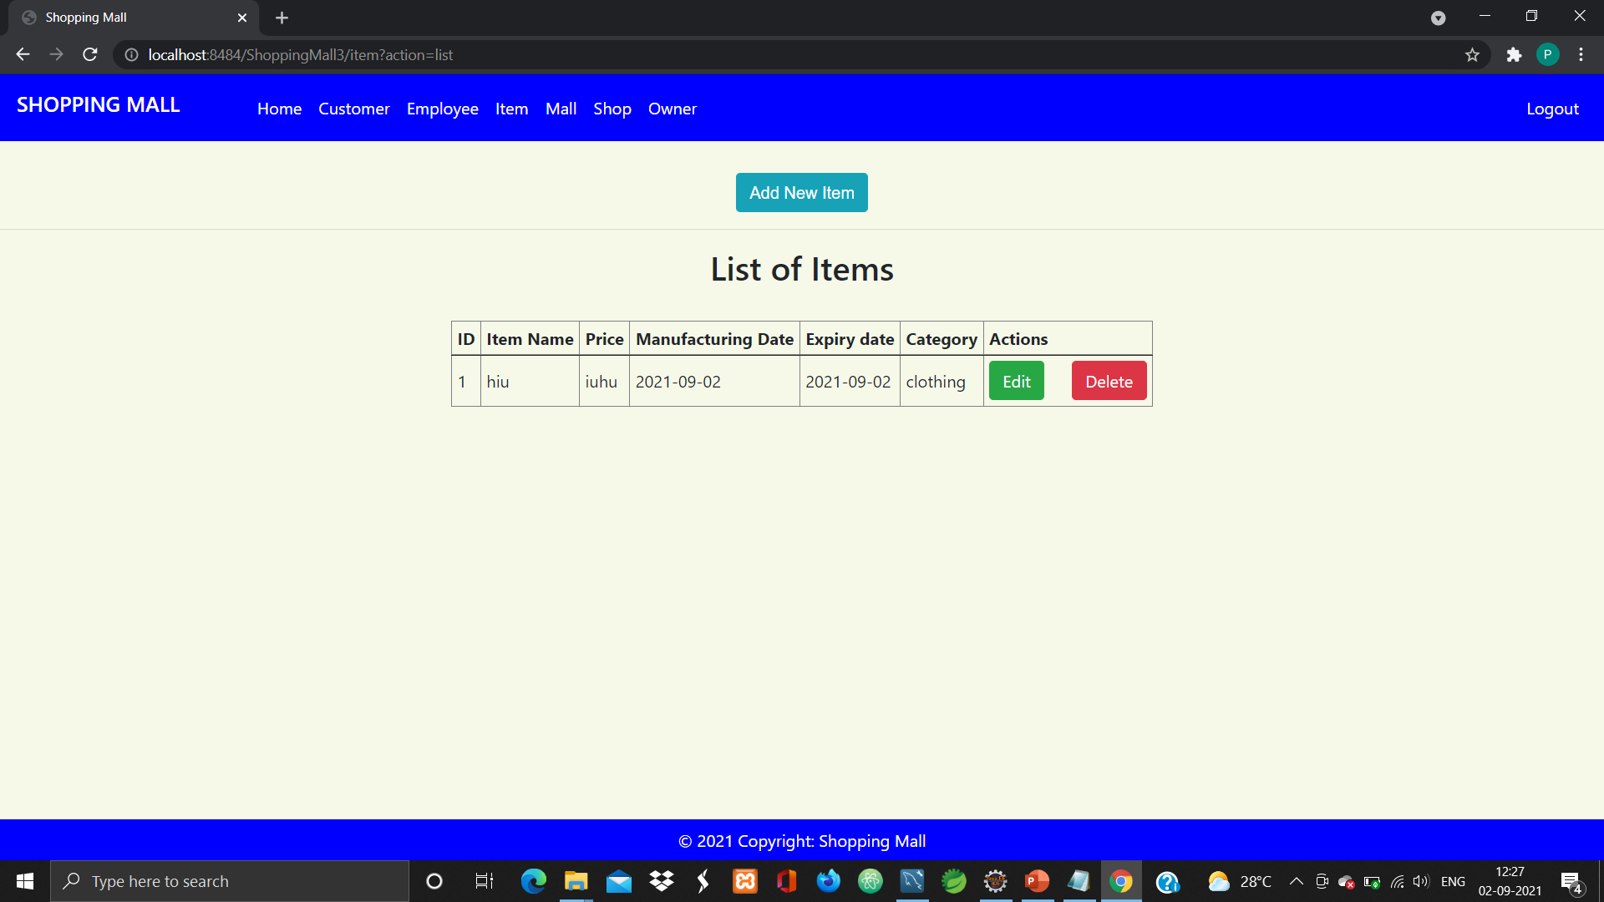

Slide 22


Slide 23
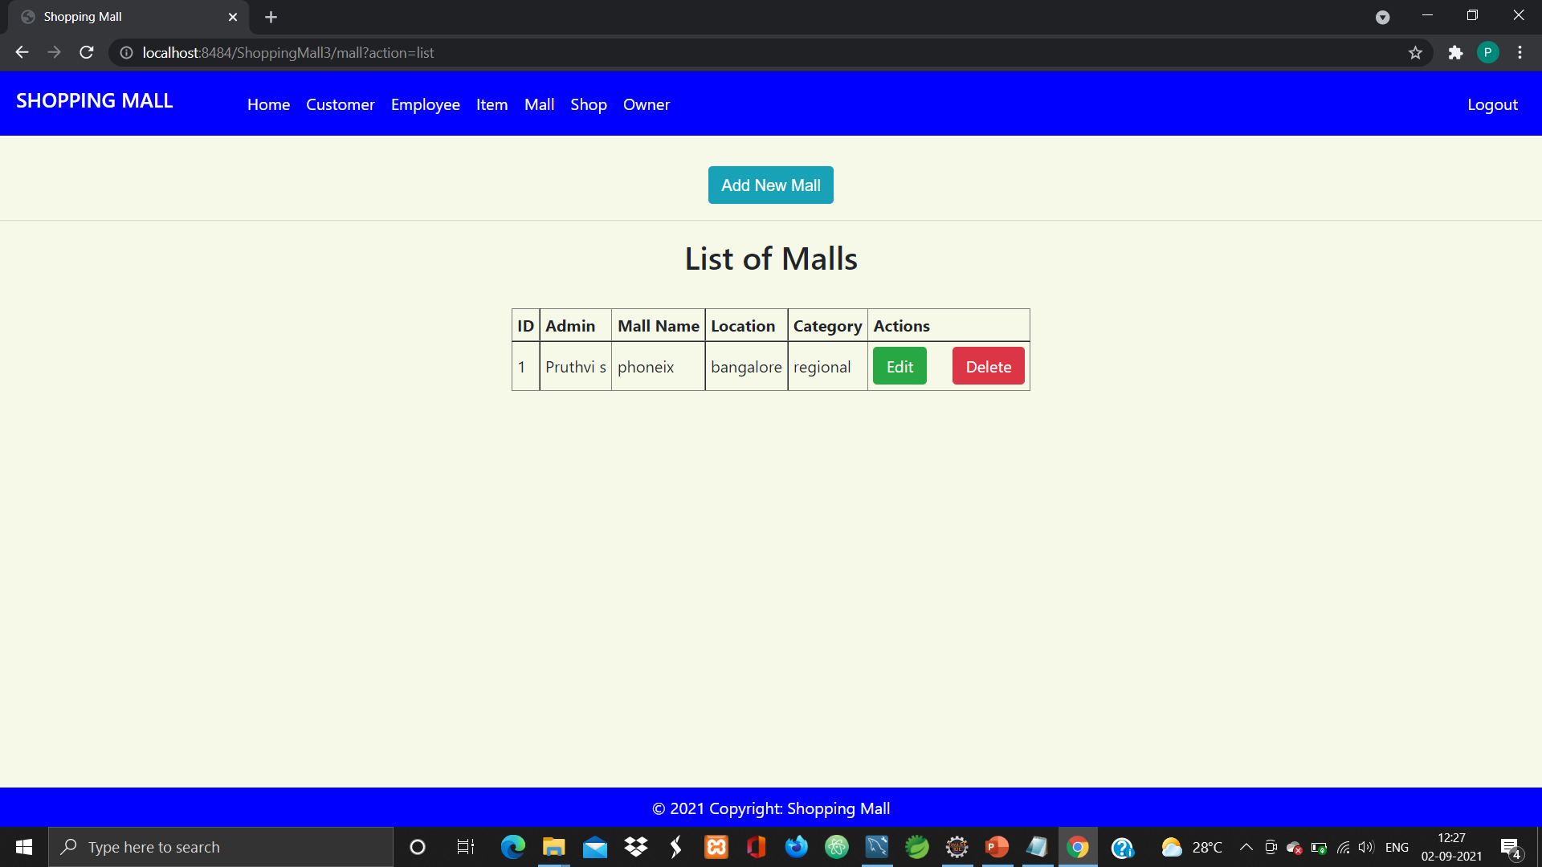

Slide 24
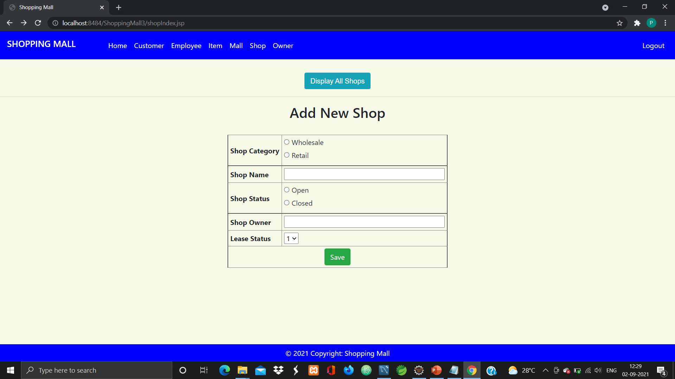

Slide 25
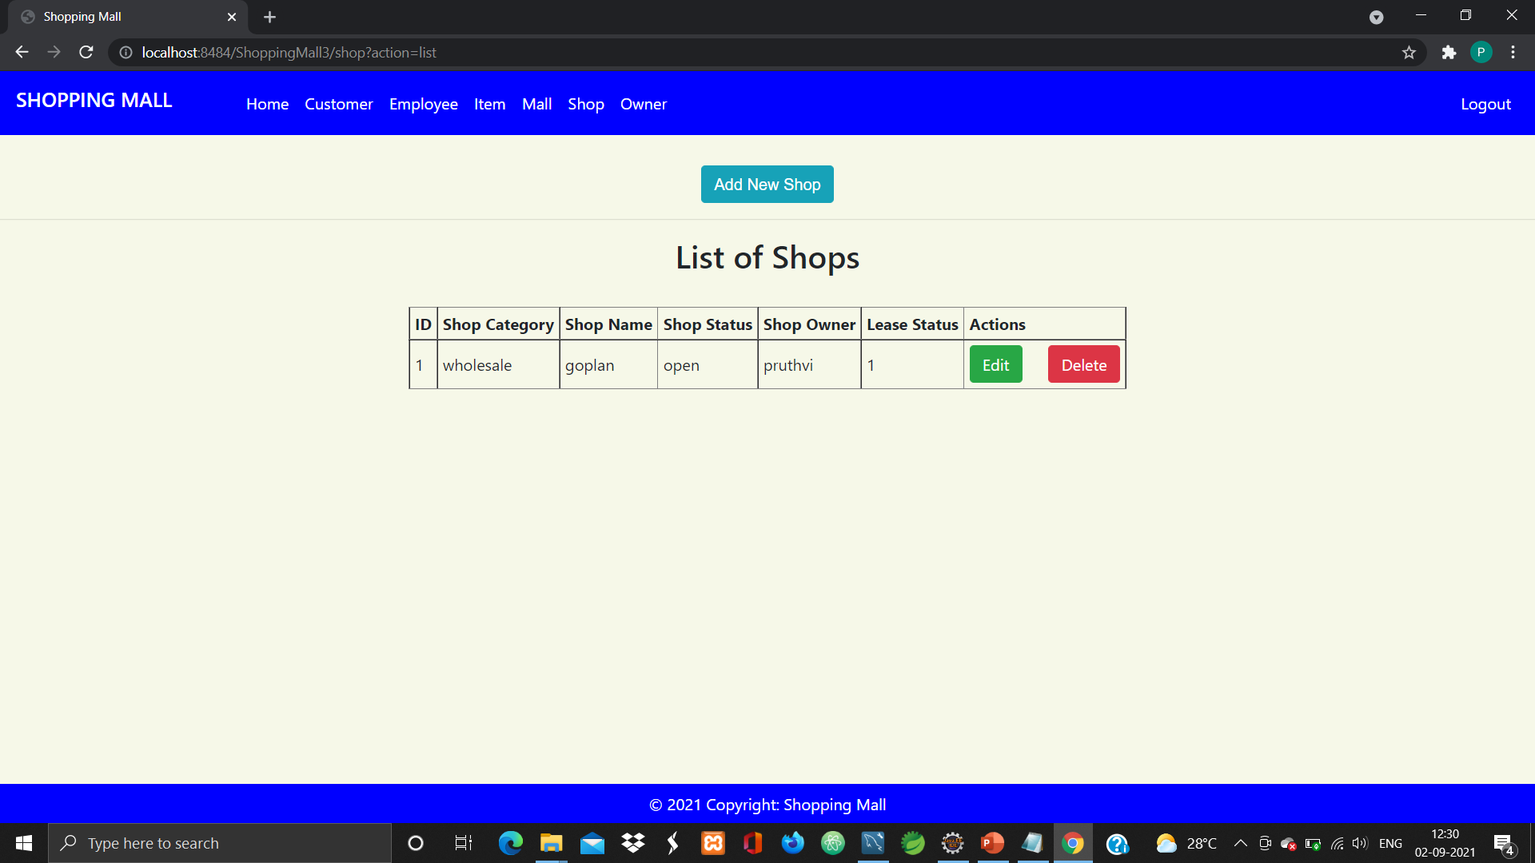

Slide 26
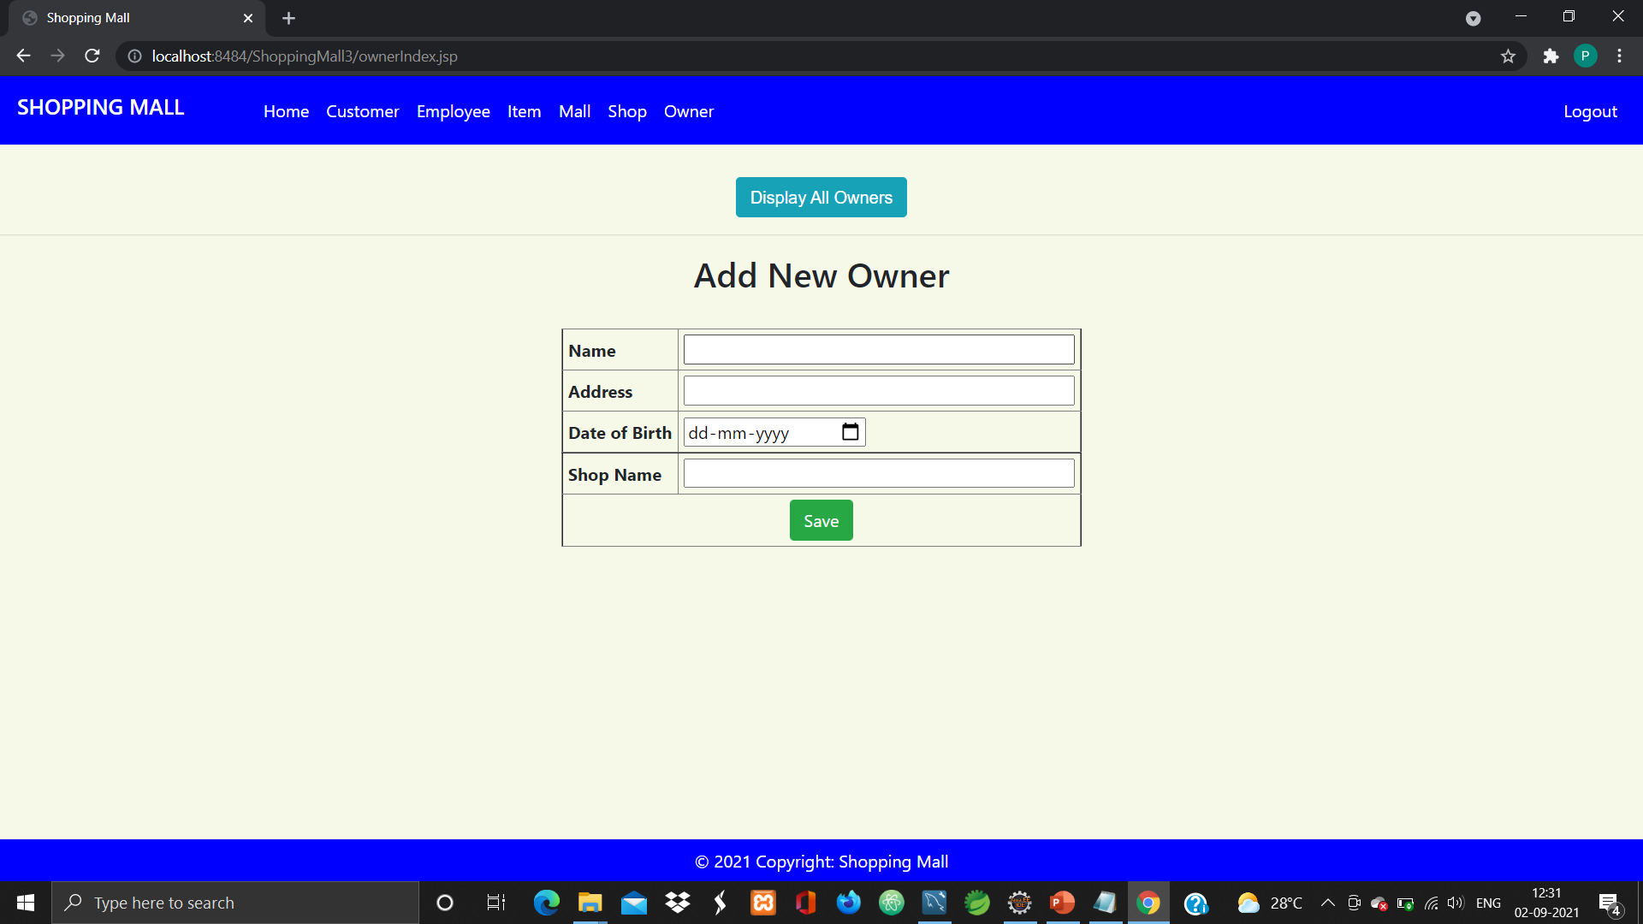

Slide 27


Slide 28
THANK YOU

